Slide 3
1. GENERAL KNOWLEDGE - 10 QUESTIONS
2. NEWS AND CURRENT AFFAIRS - 10 QUESTIONS
3. CHRISTMAS TRIVIA - 10 QUESTIONS
4. PICTURE ROUND - 9 QUESTIONS
5. WIPEOUT ROUND - 10 QUESTIONS
6. MUSIC ROUND - 10 QUESTIONS

Slide 4
GENERAL KNOWLEDGE ROUND

Slide 5
GENERAL KNOWLEDGE QUESTIONS
1. In which film does Hugh Grant play Will Thacker?
2. Which of these animals is a slang term for £500: a pony, a monkey or a cockle?
3. What was historically measured in phons?
4. Which English town became the first to be twinned with Walt Disney World?
5. Which country was Vicente Fox president of from 2000 to 2006: Mexico, Venezuela or Switzerland?
6. In which Century did Ivan the Terrible live?
7. Fionavon is a fence on which english racecourse: Aintree, Cheltenham, or Ascot?
8. What is the title given to the overall head of the judiciary in England and Wales?
9. In which building is Charles Darwin buried?
10. List 5 of the 6 IATA airport codes, for the airports in the London airport system

Slide 6
GENERAL KNOWLEDGE ANSWERS

Slide 7
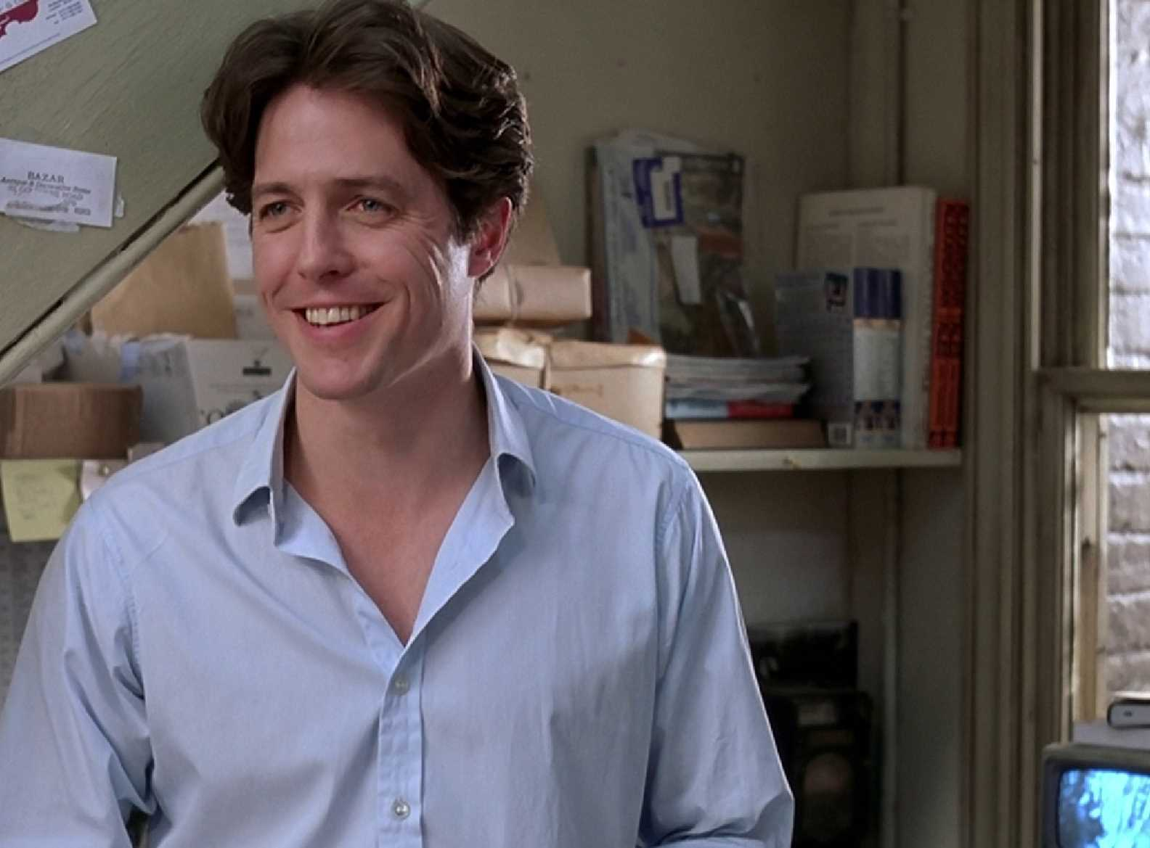
GENERAL KNOWLEDGE ANSWERS
1. In which film does Hugh Grant play Will Thacker?
1. Notting Hill

Slide 8
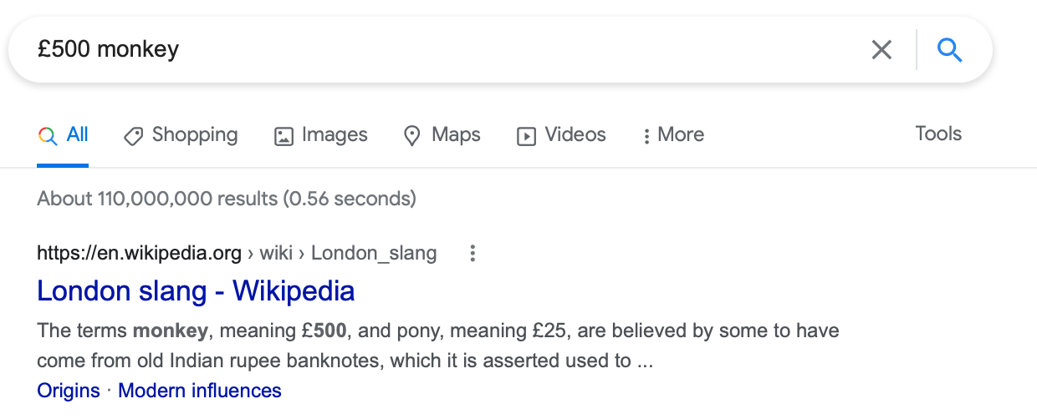
GENERAL KNOWLEDGE ANSWERS
2. Which of these animals is a slang term for £500: a pony, a monkey or a cockle?
2. Monkey

Slide 9
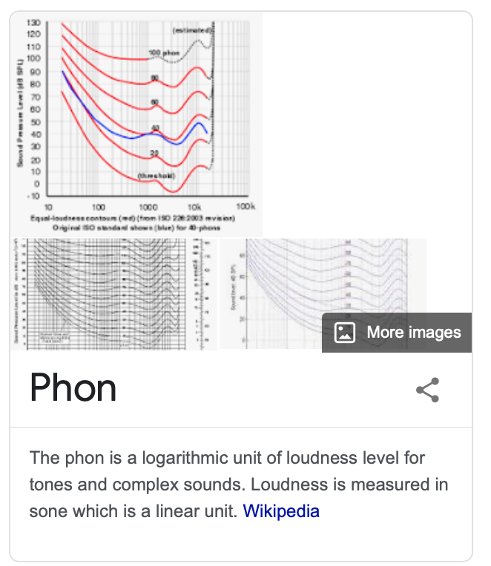
GENERAL KNOWLEDGE ANSWERS
3. What was historically measured in phons?
3. Loudness

Slide 10
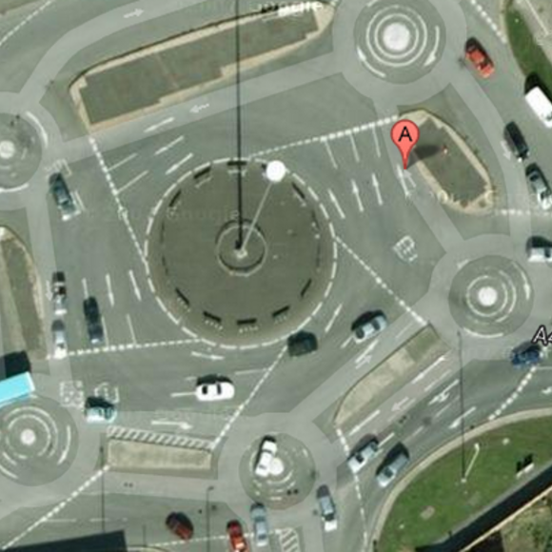
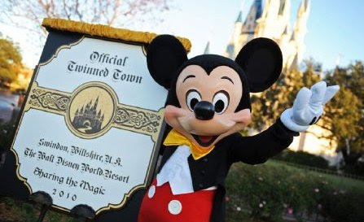
GENERAL KNOWLEDGE ANSWERS
4. Which English town became the first to be twinned with Walt Disney World?
4. Swindon

Slide 11
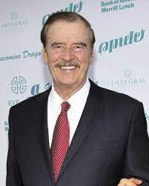
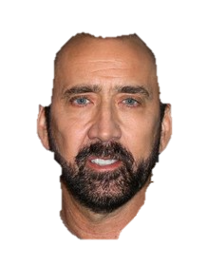
GENERAL KNOWLEDGE ANSWERS
5. Which country was Vicente Fox president of from 2000 to 2006: Mexico, Venezuela or Switzerland?
5. Mexico

Slide 12
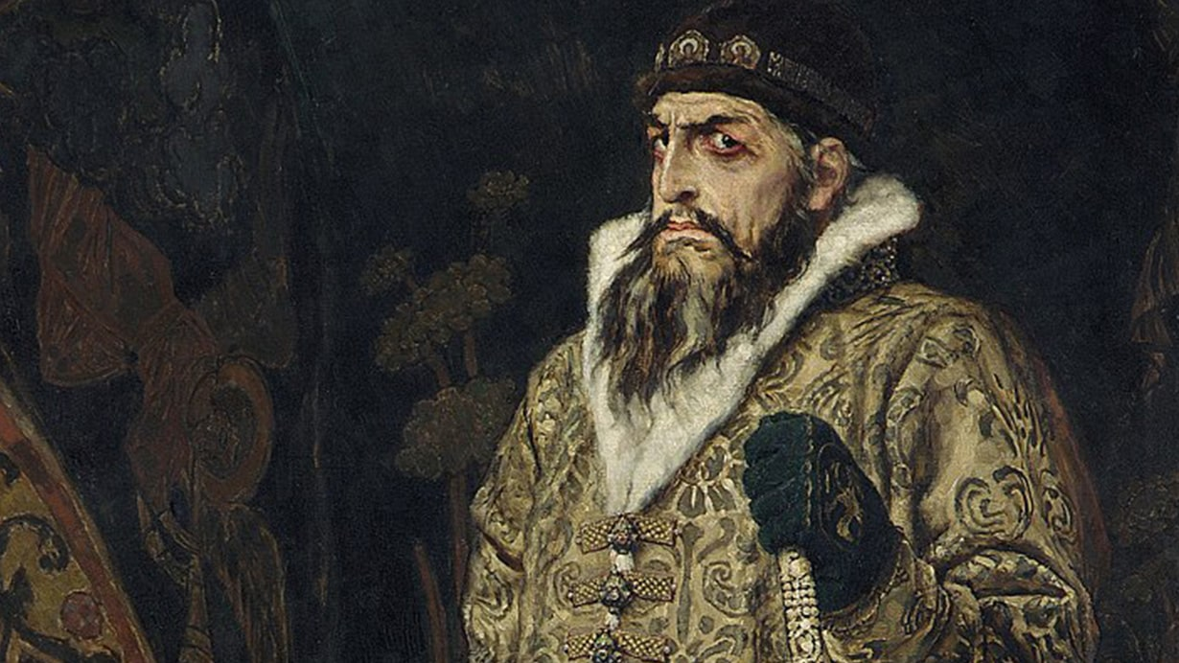
GENERAL KNOWLEDGE ANSWERS
6. In which Century did Ivan the Terrible live?
6. 16th Century (1530-1584)

Slide 13
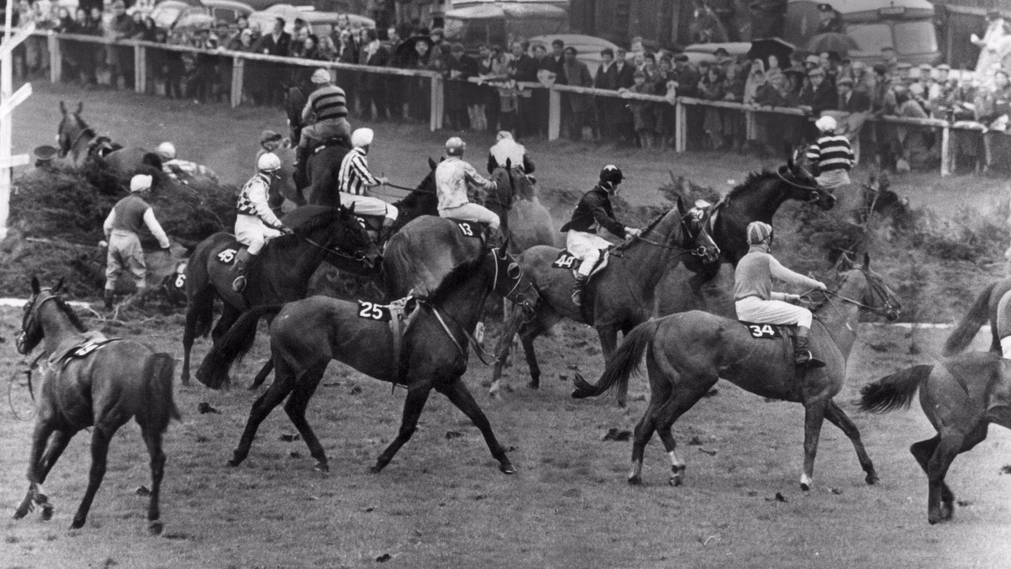
GENERAL KNOWLEDGE ANSWERS
7. Fionavon is a fence on which english racecourse: Aintree, Cheltenham, or Ascot?
7. Aintree

Slide 14
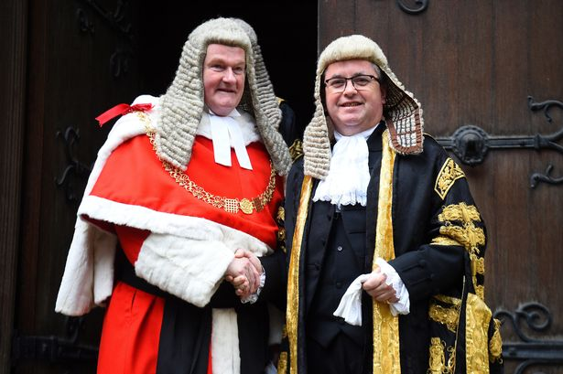
GENERAL KNOWLEDGE ANSWERS
8. What is the title given to the overall head of the judiciary in England and Wales?
8. Lord Chief Justice

Slide 15
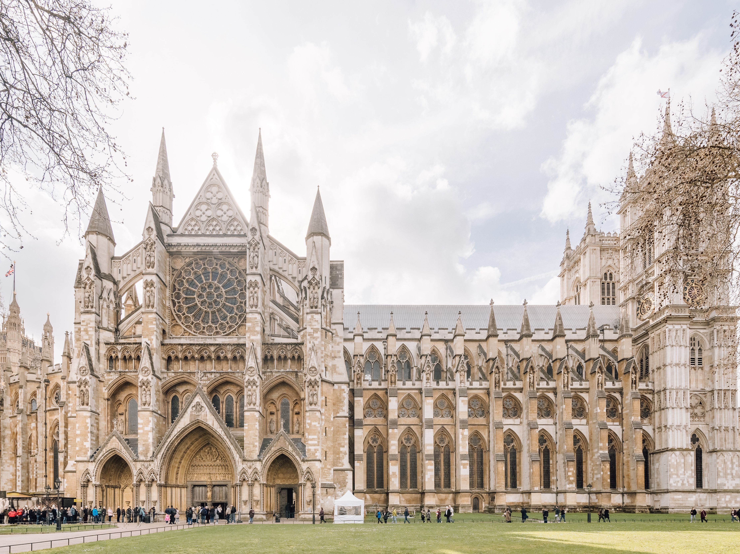
GENERAL KNOWLEDGE ANSWERS
9. In which building is Charles Darwin buried?
9. Westminster Abbey

Slide 16
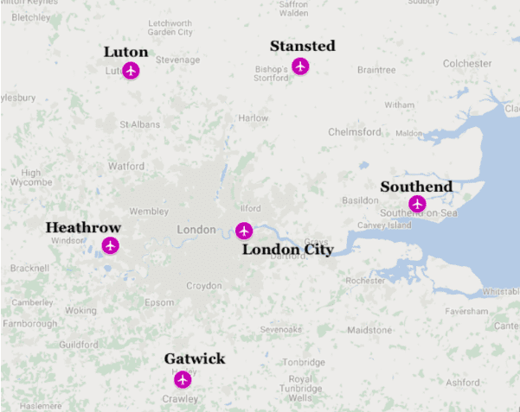
GENERAL KNOWLEDGE ANSWERS
10. List 5 of the 6 IATA airport codes, for the airports in the London airport system
LCY (London City)
LHR (Heathrow)
LGW (Gatwick)
LTN (Luton)
STN (Stansted)
SEN (Southend)

Slide 17
NEWS AND CURRENT AFFAIRS ROUND

Slide 18
NEWS AND CURRENT AFFAIRS QUESTIONS
1. The UK's Brexit Minister recently resigned - who was it?
2. Which city held an election recently, which has been reported as a risk to democracy?
3. Which prominent political activist was recently arrested after featuring in a video promoting arson against MPs?
4. A by-election in North Shropshire last week saw Conservatives lose a seat they’ve held for almost 200 years. Which party gained the seat?
5. Lewis Hamilton and Max Verstappen had a very tightly contested finish to the F1 season, but which team won the constructors championship? Red Bull, Mercedes or Ferrari?
6. How many conservative MPs rebelled against Boris Johnson's plans to introduce a domestic covid passport?
7. Which person was crowned Time magazine's person of the year?
8. Which country last week became the first in Europe to allow possession and growing of cannabis: Portugal, Malta or Romania?
9. The Bank of England recently raised the base rate of interest from it's historic low. What is the new rate?
10. Which country recently became the first to introduce a national working week shorter than 5 days: Sweden, Portugal, or UAE?

Slide 19
NEWS AND CURRENT AFFAIRS ANSWERS

Slide 20
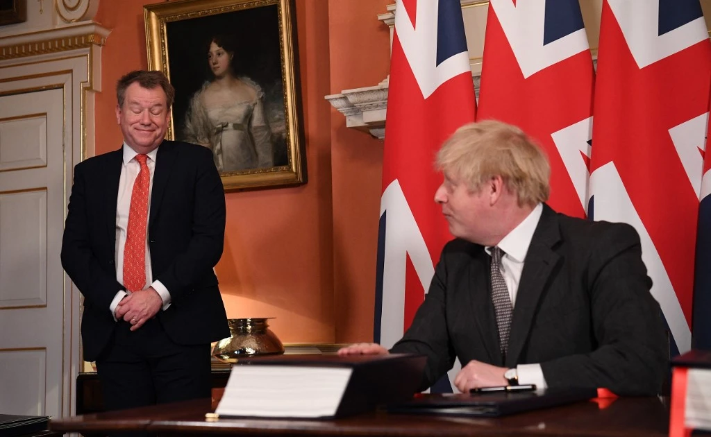
NEWS AND CURRENT AFFAIRS ANSWERS
1. The UK's Brexit Minister recently resigned - who was it?
1. Lord David Frost

Slide 21
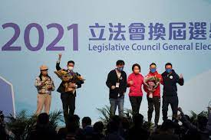
NEWS AND CURRENT AFFAIRS ANSWERS
2. Which city held an election recently, which has been reported as a risk to democracy?
2. Hong Kong

Slide 22
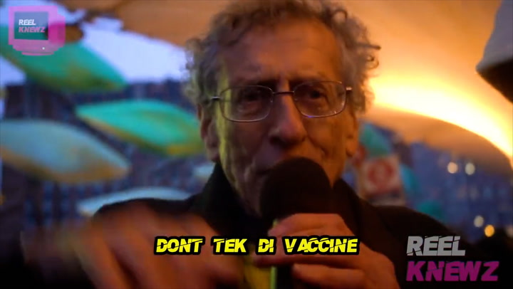
NEWS AND CURRENT AFFAIRS ANSWERS
3. Which prominent political activist was recently arrested after featuring in a video promoting arson against MPs?
3. Piers Corbyn

Slide 23
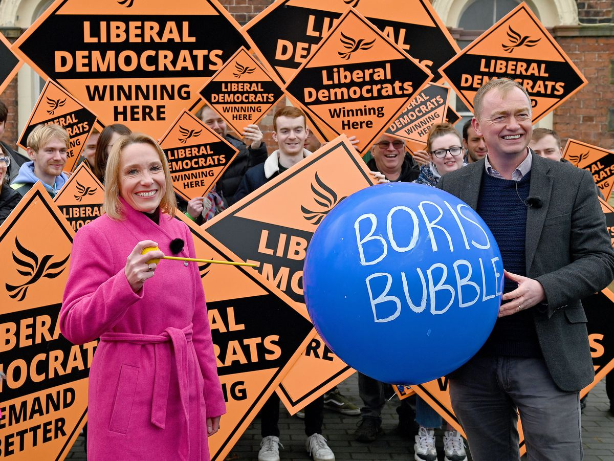
NEWS AND CURRENT AFFAIRS ANSWERS
4. A by-election in North Shropshire last week saw Conservatives lose a seat they’ve held for
almost 200 years. Which party gained the seat?
4. Liberal Democrats

Slide 24
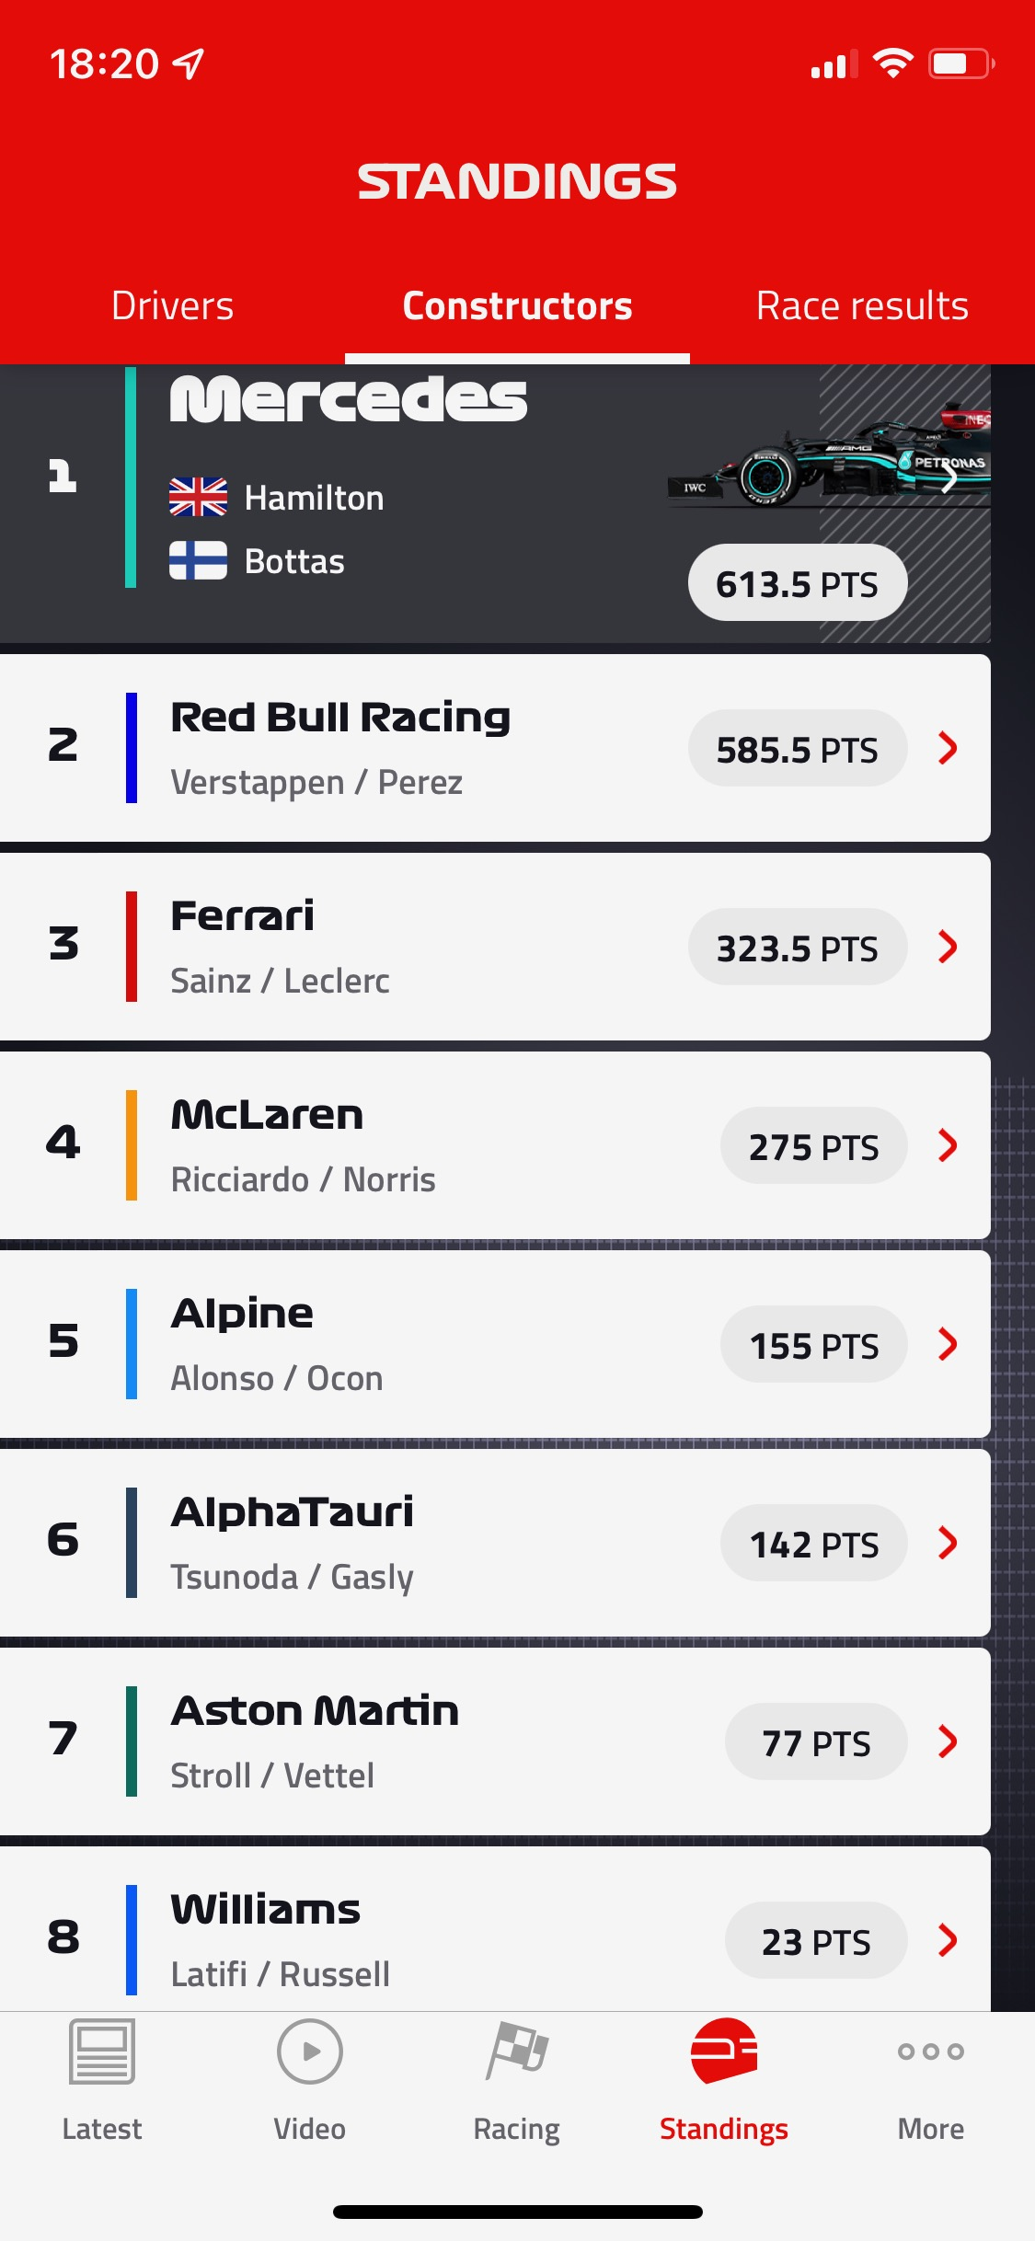
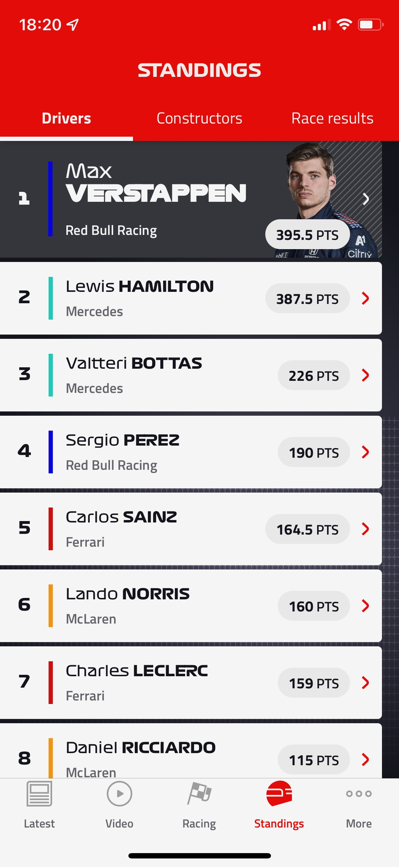
NEWS AND CURRENT AFFAIRS ANSWERS
5. Lewis Hamilton and Max Verstappen had a very tightly contested finish to the F1 season,
but which team won the constructors championship? Red Bull, Mercedes or Ferrari?
5. Mercedes

Slide 25
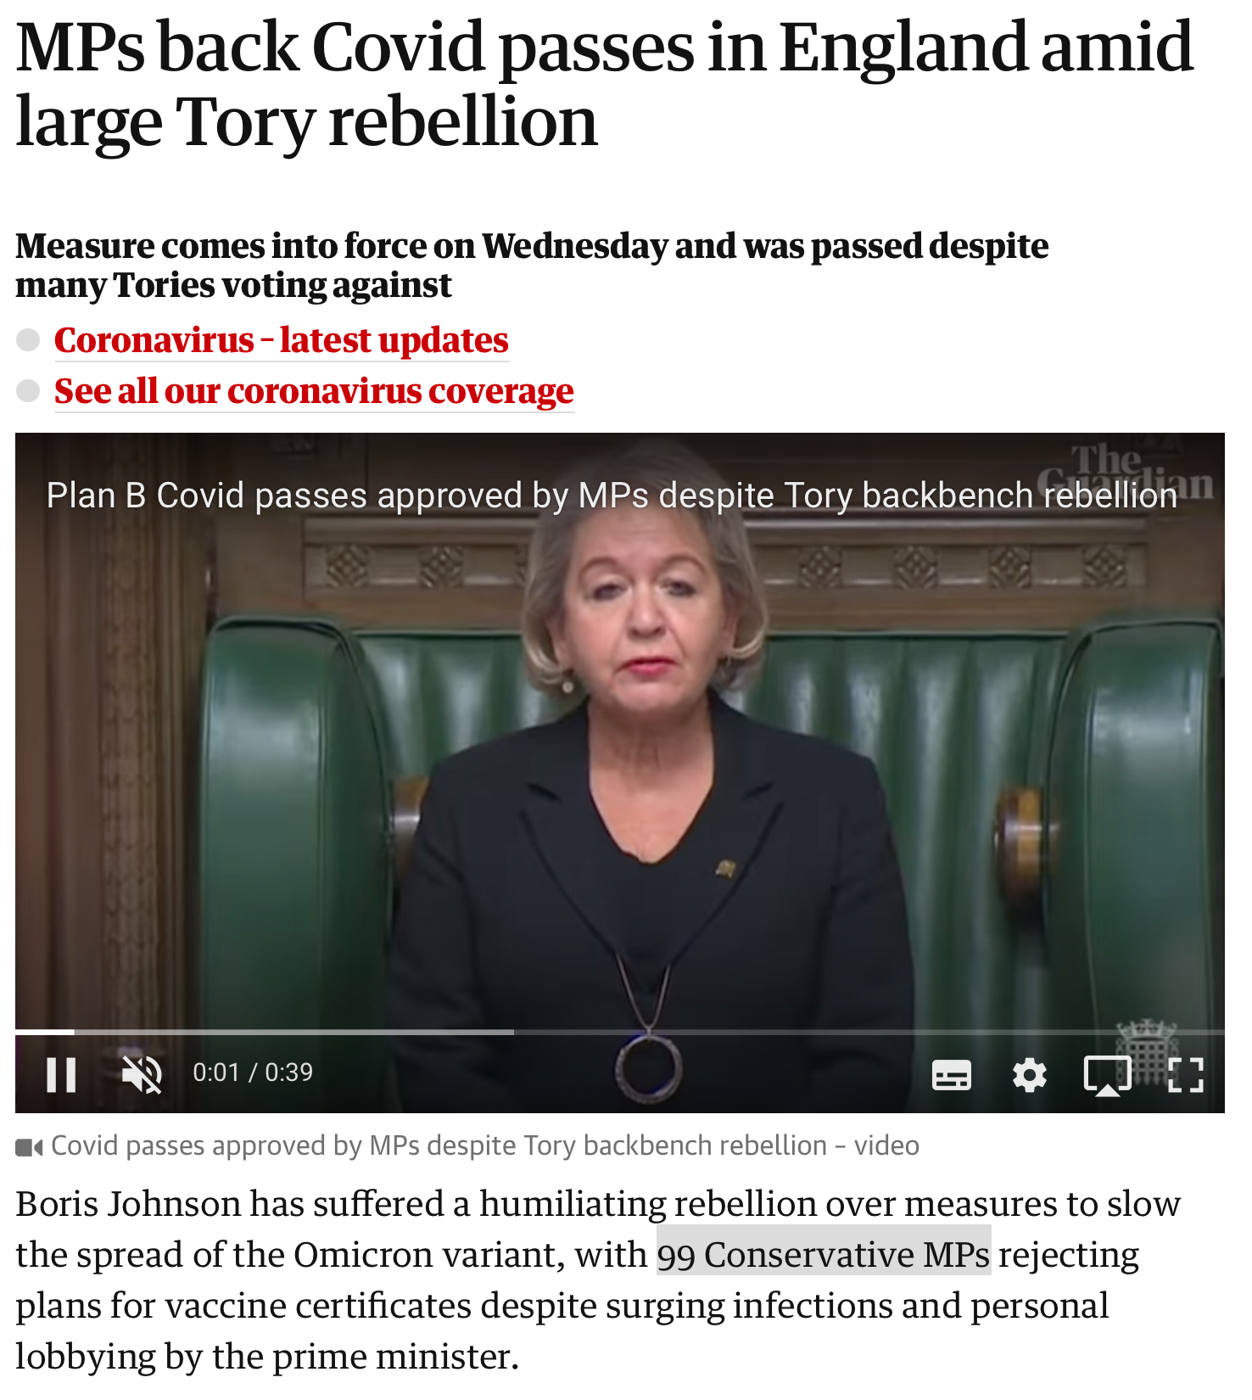
NEWS AND CURRENT AFFAIRS ANSWERS
6. How many conservative MPs rebelled against Boris Johnson's plans to introduce a domestic covid passport?
6. 99

Slide 26
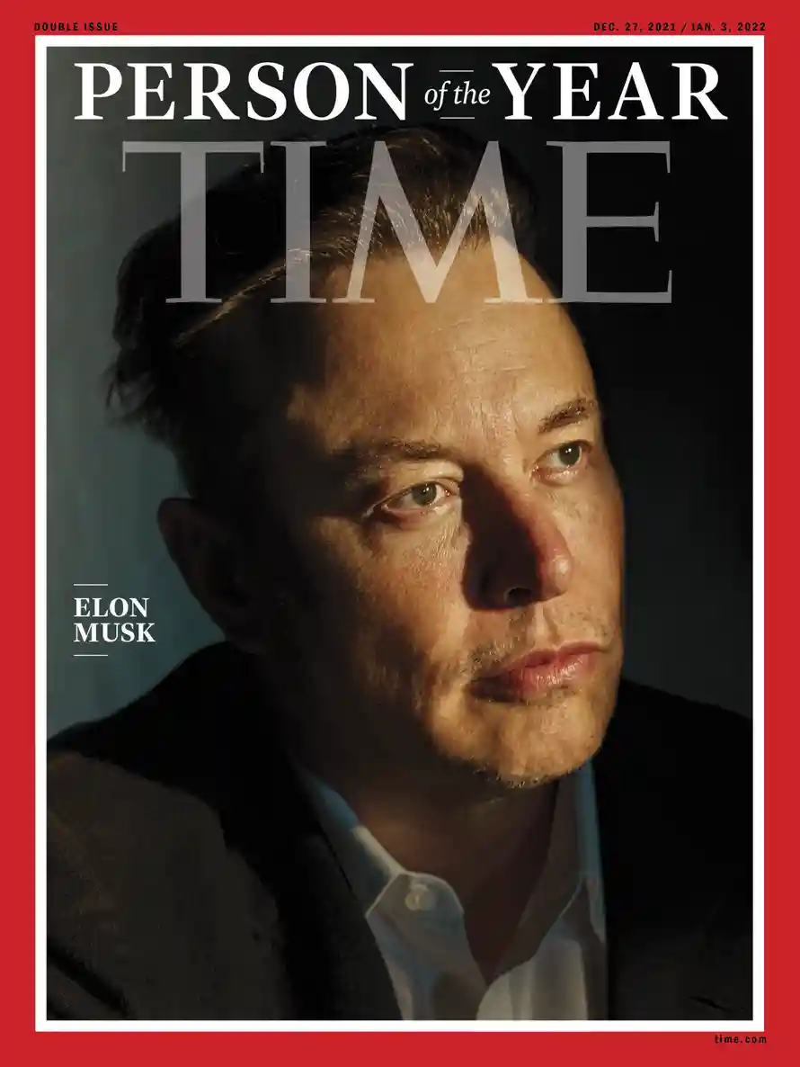
NEWS AND CURRENT AFFAIRS ANSWERS
7. Which person was crowned Time magazine's person of the year?
7. Elon Musk

Slide 27
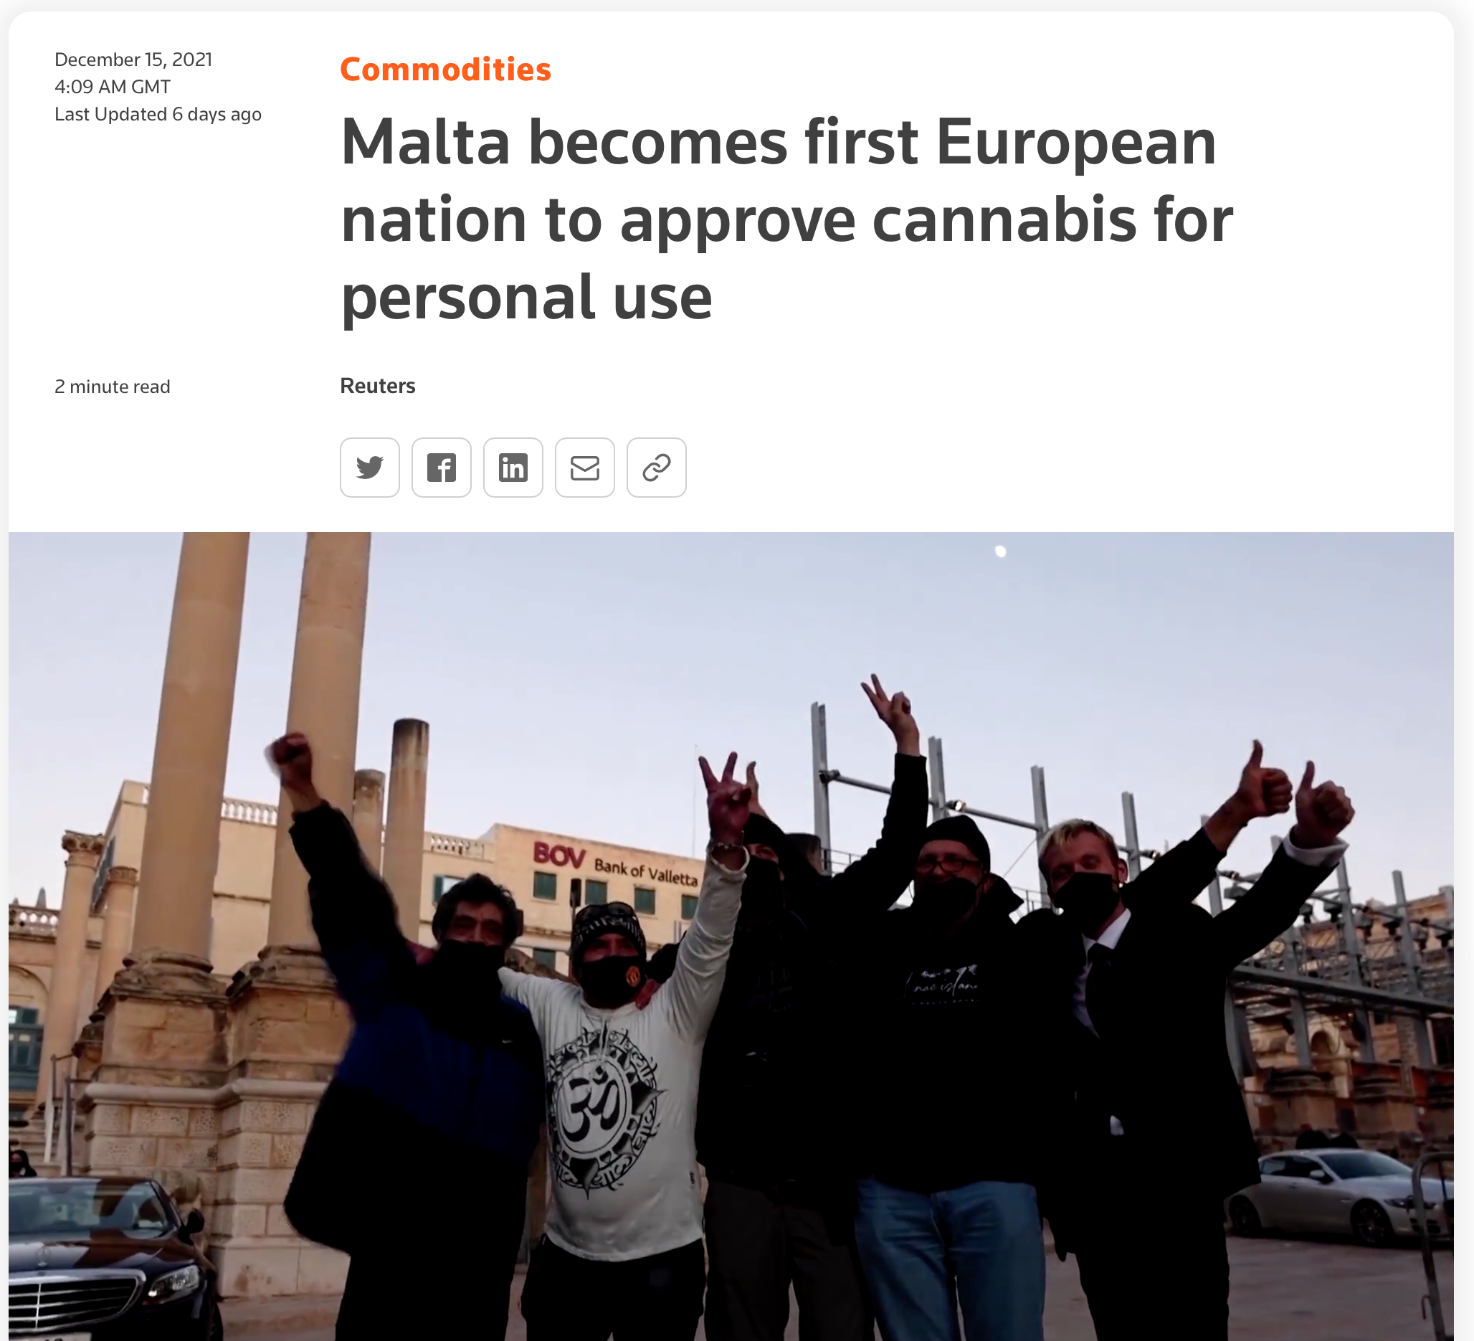
NEWS AND CURRENT AFFAIRS ANSWERS
8. Which country last week became the first in Europe to allow possession and growing of cannabis: Portugal, Malta or Romania?
8. Malta

Slide 28
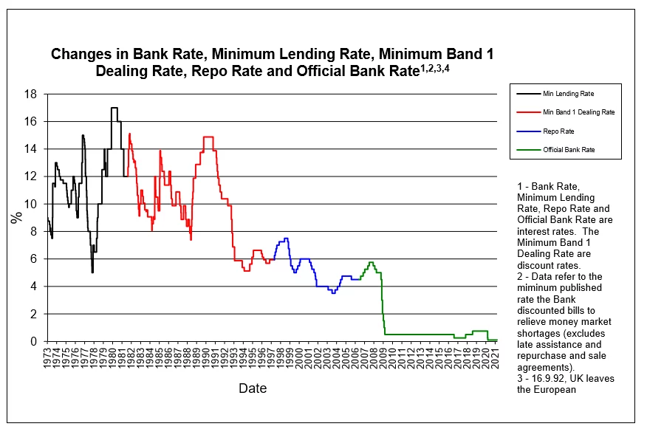
NEWS AND CURRENT AFFAIRS ANSWERS
9. The Bank of England recently raised the base rate of interest from it's historic low. What is the new rate?
9. 0.25%

Slide 29
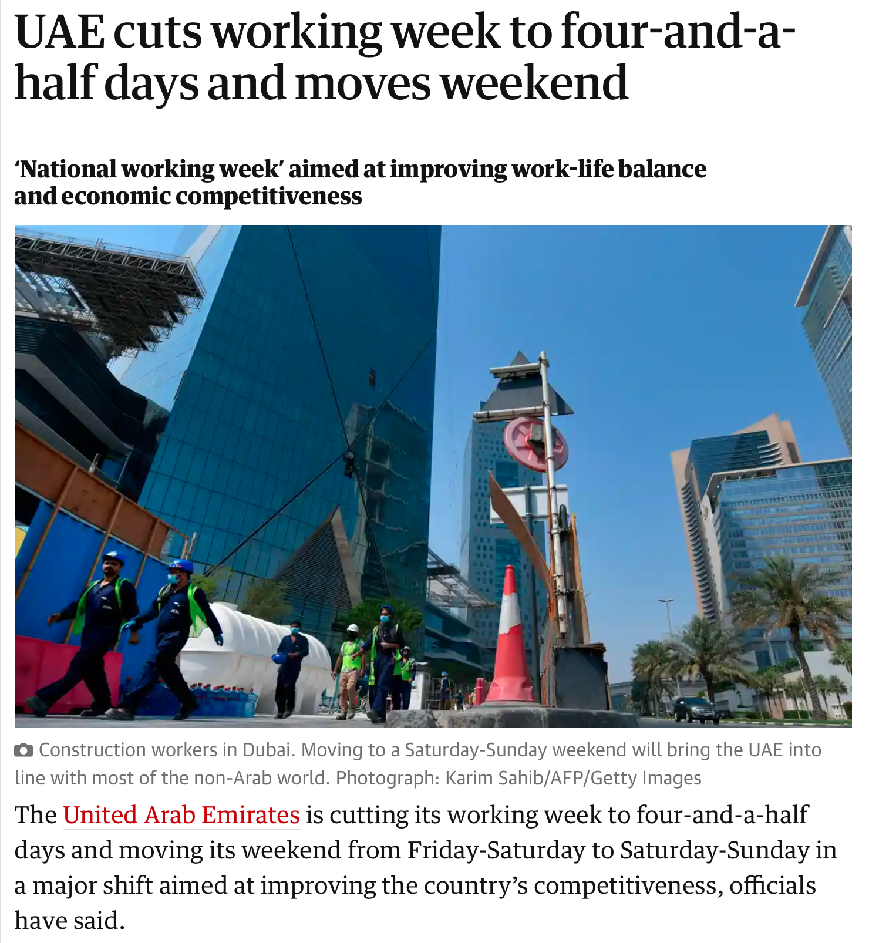
NEWS AND CURRENT AFFAIRS ANSWERS
10. Which country recently became the first to introduce a national working week shorter than 5 days: Sweden, Portugal, or UAE?
10. UAE

Slide 30
CHRISTMAS TRIVIA ROUND

Slide 31
CHRISTMAS TRIVIA QUESTIONS
1. In the christmas movie Elf, name any of the 3 rules in "The Code of Elves"
2. How much can Santa Clause actors earn for the month of December: £4,500, £8,000, £17,000 or £26,000?
3. In what century were Christmas celebrations banned by the government?
4. In the Peep Show Christmas episode, according to Mark's dad, which vegetable is traditional at Christmas?
5. Who was crowned King of England on Christmas Day, 955 years ago?
6. In which 1996 Christmas film does Arnold Schwarzenegger feature in?
7. How many lights does Clark Griswold put on his house in National Lampoon's Christmas Vacation?
8. How many versions of "Do they know it's Christmas?" have been made? 4 or 6?
9. What month did Harrods open their Christmas department?
10. List 2 of the 3 artists to have a UK Christmas number 1, in 3 consecutive years

Slide 32
CHRISTMAS TRIVIA ANSWERS

Slide 33
CHRISTMAS TRIVIA ANSWERS
1. In the christmas movie Elf, name any of the 3 rules in "The Code of Elves"
1. Treat Every day like Christmas
2. There's room for everyone on the nice list
3. The best way to spread christmas cheer, is singing loud for all to hear

Slide 34
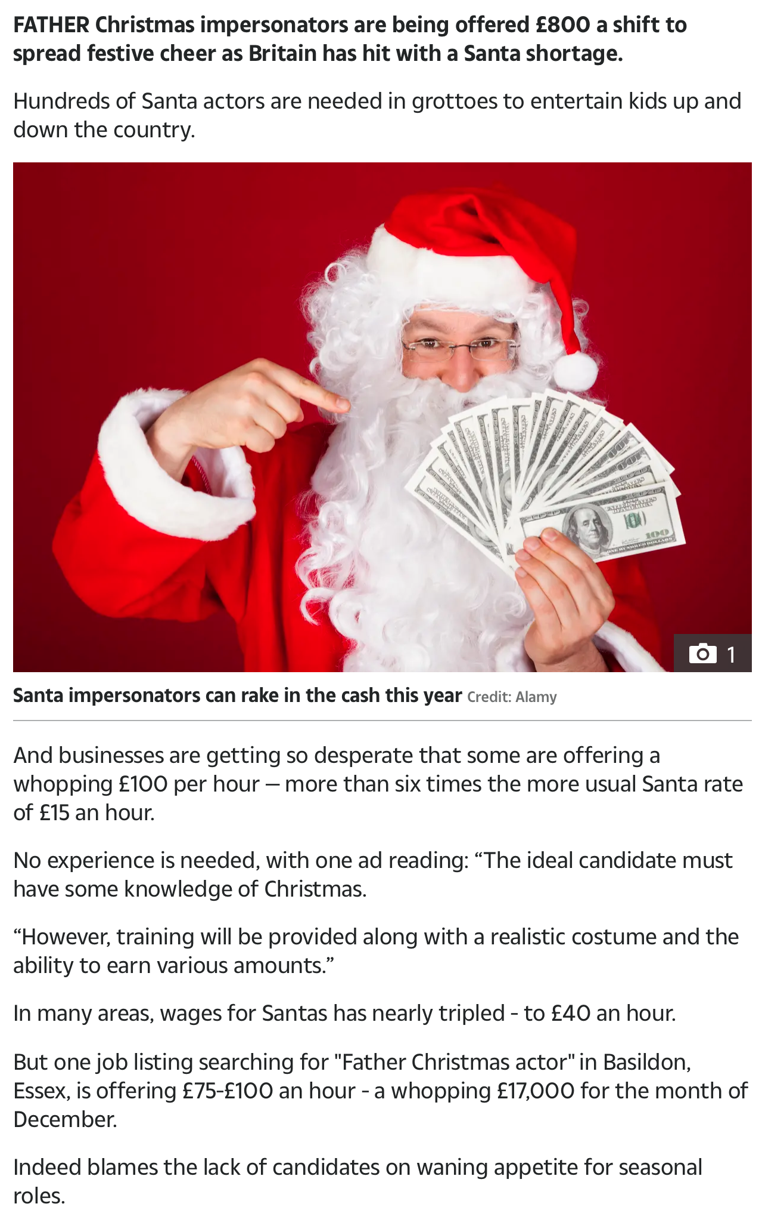
CHRISTMAS TRIVIA ANSWERS
2. How much can Santa Clause actors earn for the month of December: £4,500, £8,000, £17,000 or £26,000?
2. 17000

Slide 35
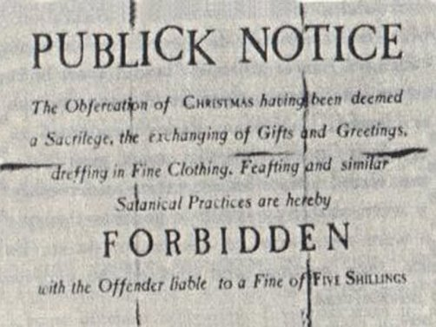
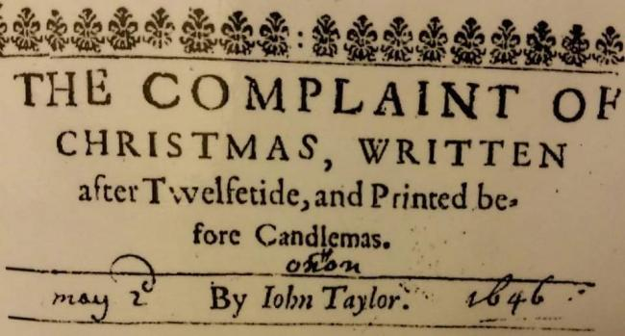
CHRISTMAS TRIVIA ANSWERS
3. In what century were Christmas celebrations banned by the government?
3. 17th (1647-1660)

Slide 36
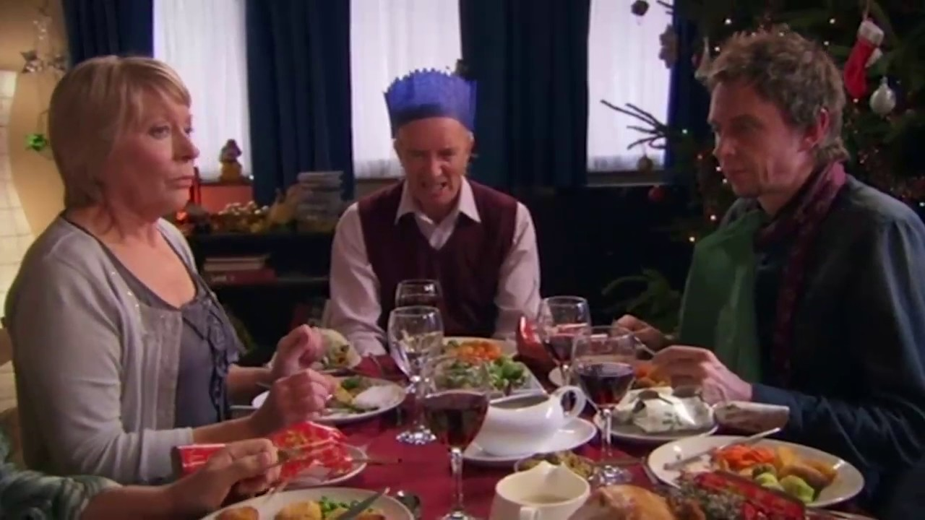
CHRISTMAS TRIVIA ANSWERS
4. In the Peep Show Christmas episode, according to Mark's dad, which vegetable is traditional at christmas?
4. Cauliflower

Slide 37
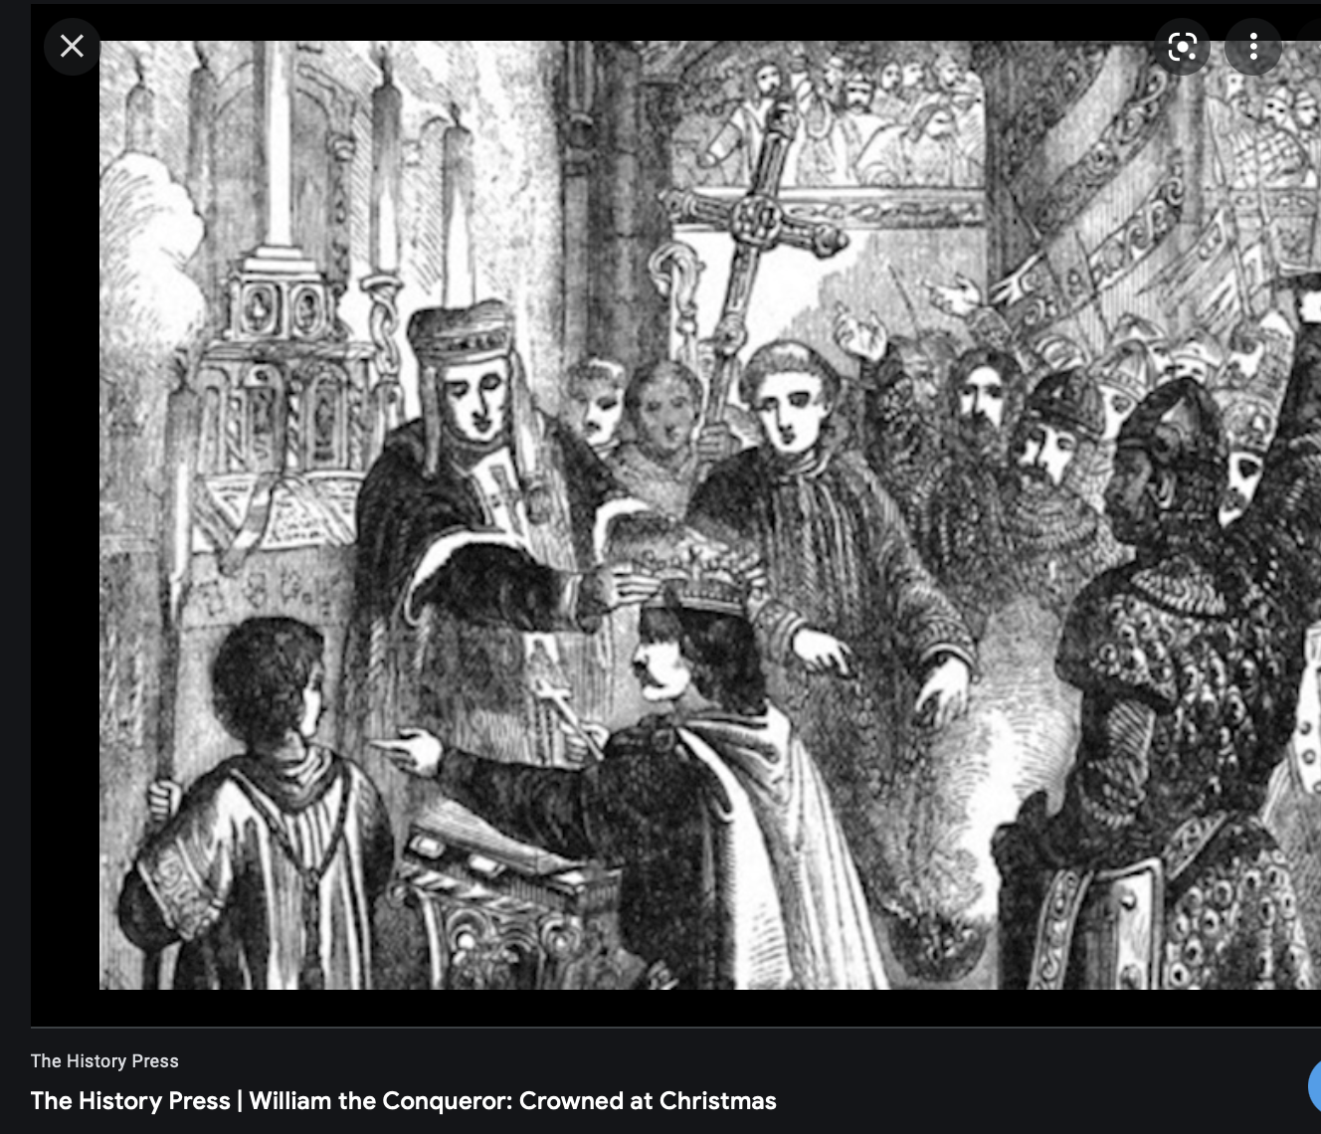
CHRISTMAS TRIVIA ANSWERS
5. Who was crowned King of England on Christmas Day, 955 years ago?
5. William the Conqueror

Slide 38
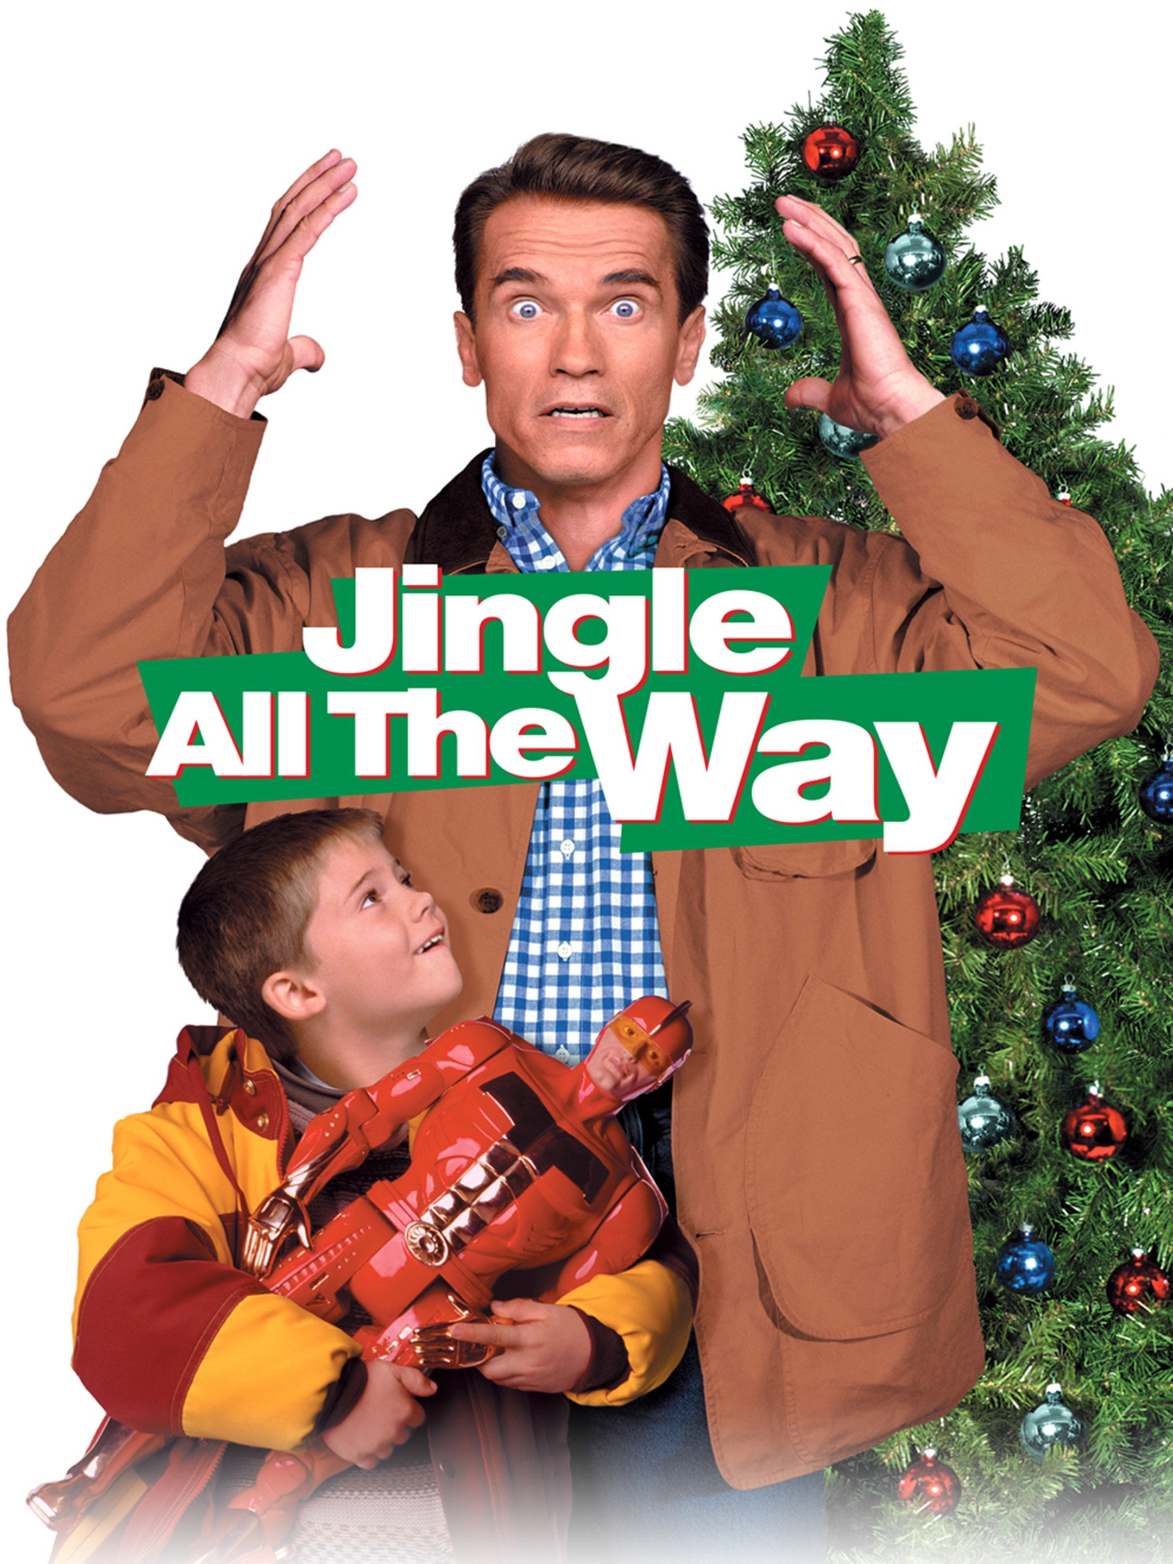
CHRISTMAS TRIVIA ANSWERS
6. In which 1996 Christmas film does Arnold Schwarzenegger feature in?
6. Jingle All the Way

Slide 39
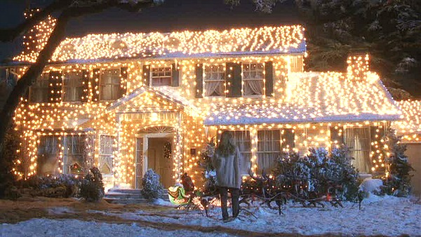
CHRISTMAS TRIVIA ANSWERS
7. How many lights does Clark Griswold put on his house in National Lampoon's Christmas Vacation?
7. 25000

Slide 40
CHRISTMAS TRIVIA ANSWERS
8. How many versions of "Do they know it's Christmas?" have been made? 4 or 6?
8. 4

Slide 41
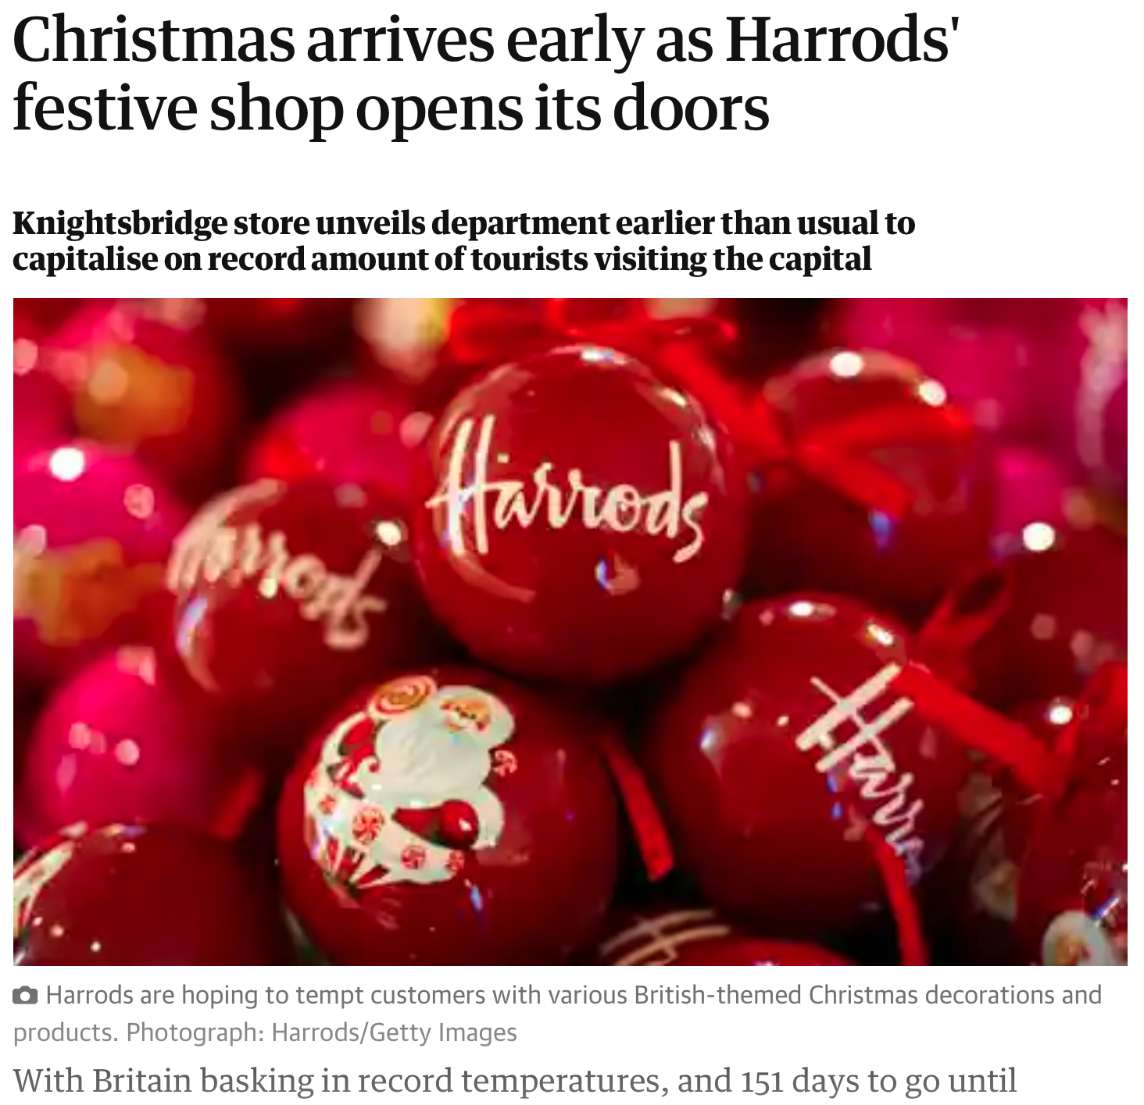
CHRISTMAS TRIVIA ANSWERS
9. What month did Harrods open their Christmas department?
9. July

Slide 42
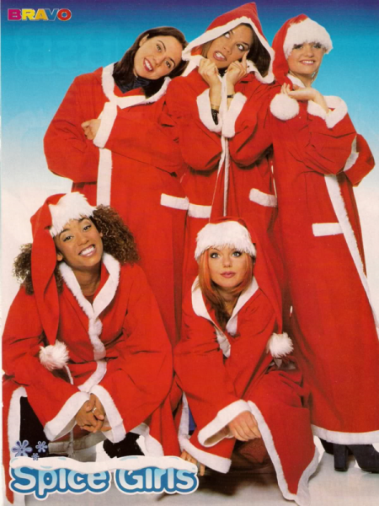
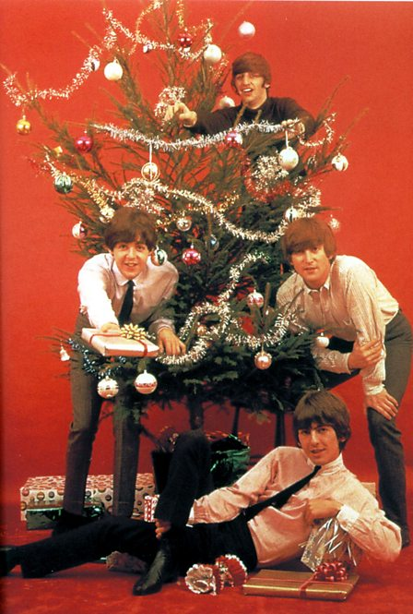
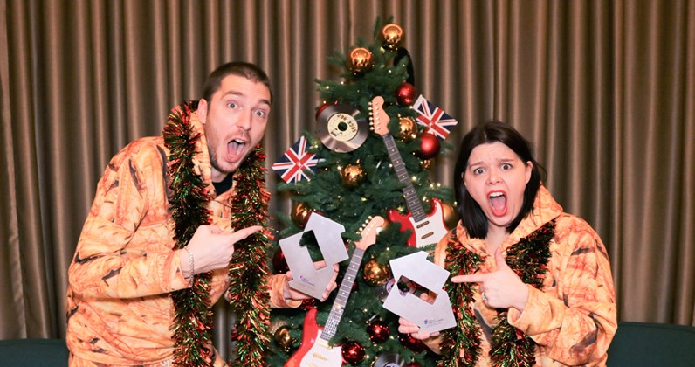
CHRISTMAS TRIVIA ANSWERS
10. List 2 of the 3 artists to have a UK Christmas number 1, in 3 consecutive years
10. The Spice Girls, The Beatles, LadBaby

Slide 43
PICTURE ROUND

Slide 44
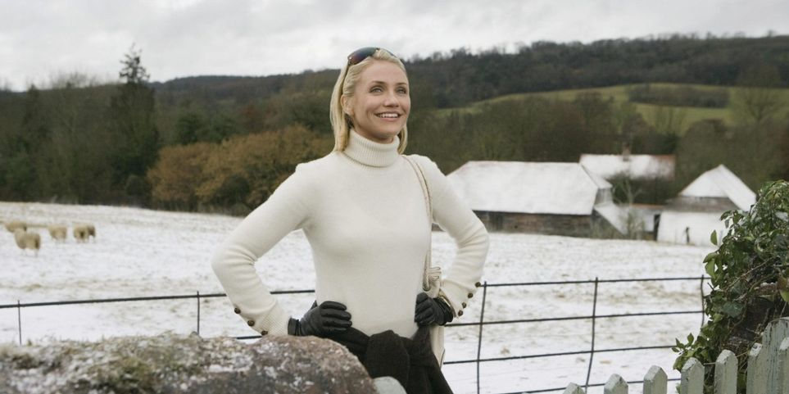
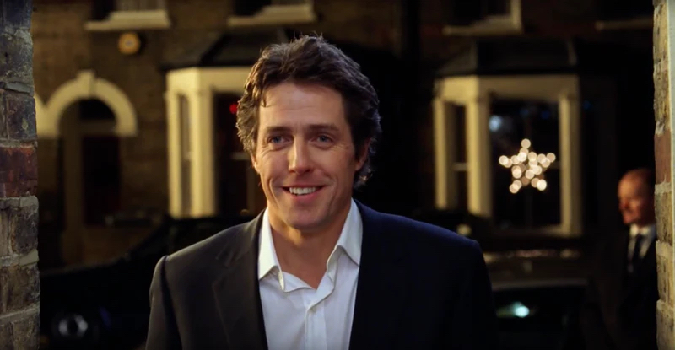
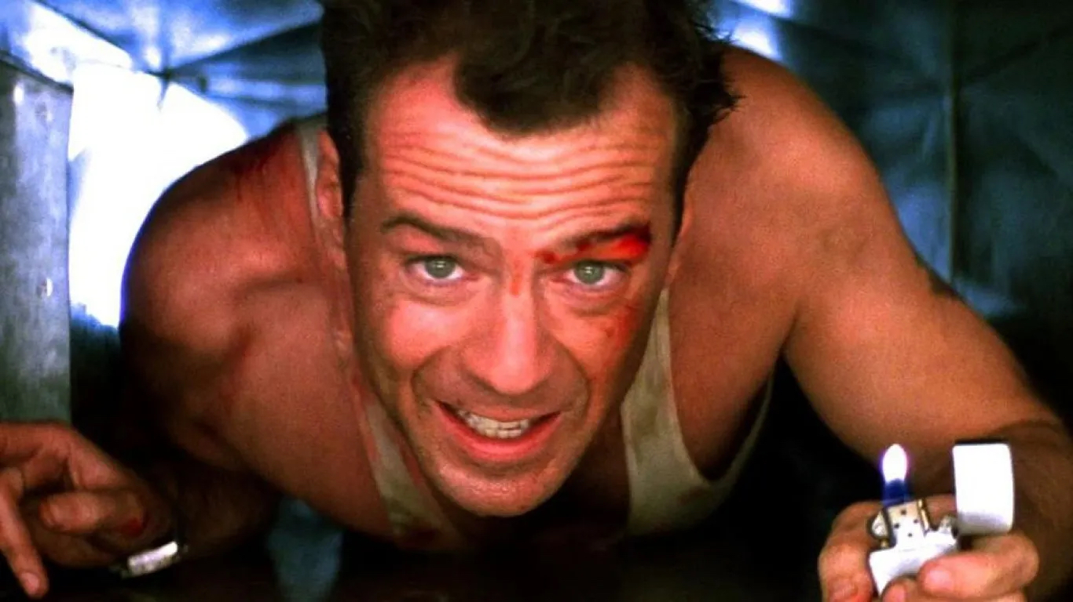
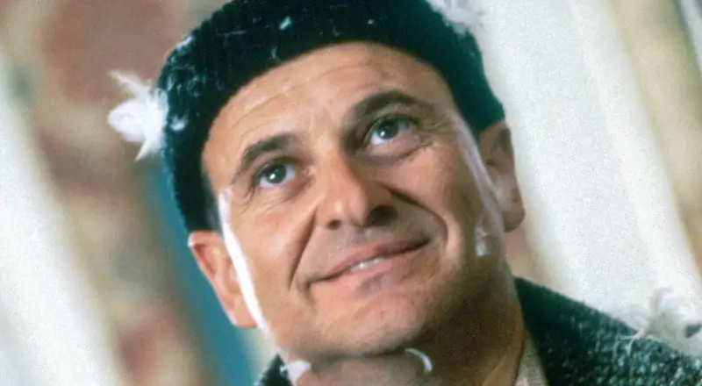
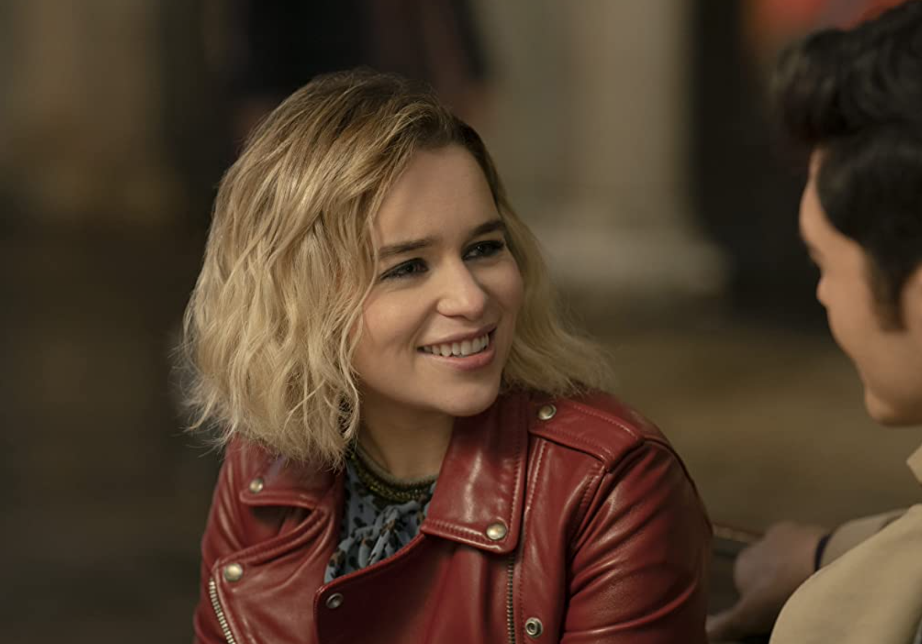
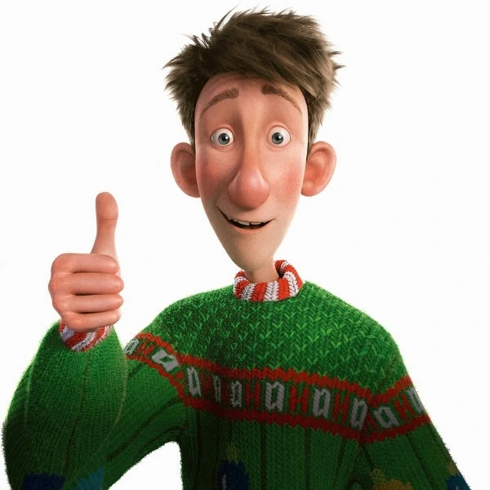
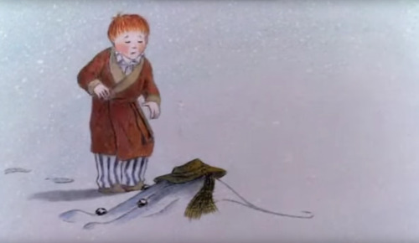
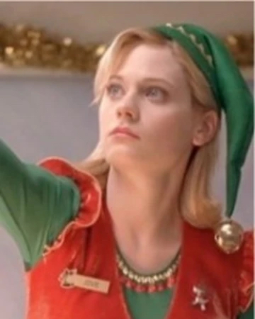
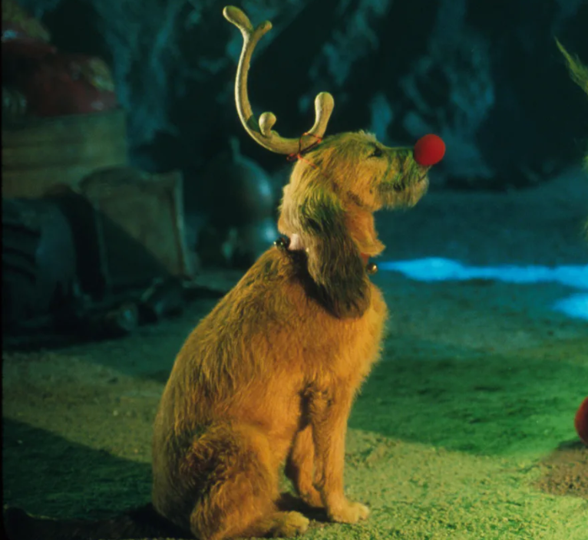
1.
2.
3.
4.
5.
6.
7.
8.
9.

Slide 45
PICTURE ROUND ANSWERS

Slide 46
PICTURE ROUND ANSWERS
1.
Amanda, The Holiday

Slide 47
PICTURE ROUND ANSWERS
2.
David, Love Actually

Slide 48
PICTURE ROUND ANSWERS
3.
John McLane, Die Hard

Slide 49
PICTURE ROUND ANSWERS
4.
Harry, Home Alone

Slide 50
PICTURE ROUND ANSWERS
5.
Kate, Last Christmas

Slide 51
PICTURE ROUND ANSWERS
6.
Arthur, Arthur Christmas

Slide 52
PICTURE ROUND ANSWERS
7.
James, The Snowman

Slide 53
PICTURE ROUND ANSWERS
8.
Jovie, Elf

Slide 54
PICTURE ROUND ANSWERS
9.
Max, The Grinch

Slide 56
QUESTION 1.
Which US boxer was nicknamed "The Hurricane"?
A. Muhammad Ali
B. Mike Tyson
C. Joe Frazier
D. Rubin Carter

Slide 57
QUESTION 2.
In which country did Spotify originate?
A. United States
B. Sweden
C. Israel
D. France

Slide 58
QUESTION 3.
What is the more common term for protanopia?
A. Colour blindness
B. Baldness
C. Double jointed
D. Skin Rash

Slide 59
QUESTION 4.
Which of these snooker players holds the most ranking titles?
A. Stephen Hendry
B. John Higgins
C. Steve Davis
D. Mark Williams

Slide 60
QUESTION 5.
Which company manufactured the games console Dreamcast?
A. Nintendo
B. Sony
C. Sega
D. Microsoft

Slide 61
QUESTION 6.
In which decade is Halley's Comet next predicted to be visible from earth?
A. 2040s
B. 2050s
C. 2060s
D. 2070s

Slide 62
QUESTION 7.
Which animal used to be called a Camelopard
A. Camel
B. Leopard
C. Zebra
D. Giraffe

Slide 63
QUESTION 8.
Which of these was the third book to be released, in the popular series by Suzanne Collins
A. Catching Fire
B. Mockingjay
C. The Hunger Games
D. The Ballad of Songbirds and Snakes

Slide 64
QUESTION 9.
Which formula 1 driver is/was known as "The Iceman"?
A. Michael Schumacher
B. Niki Lauda
C. Kimi Raikkonen
D. Jenson Button

Slide 65
QUESTION 10.
The cor anglais belongs to which section of an orchestra?
A. Strings
B. Woodwind
C. Brass
D. Percussion

Slide 67
Which US boxer was nicknamed "The Hurricane"?
Q1.
A. Muhammad Ali
B. Mike Tyson
C. Joe Frazier
D. Rubin Carter

Slide 68
In which country did Spotify originate?
Q2.
A. United States
B. Sweden
C. Israel
D. France

Slide 69
What is the more common term for protanopia?
Q3.
A. Colour blindness
B. Baldness
C. Double jointed
D. Skin Rash

Slide 70
Which of these snooker players holds the most ranking titles?
Q4.
A. Stephen Hendry
B. John Higgins
C. Steve Davis
D. Mark Williams

Slide 71
Which company manufactured the games console Dreamcast?
Q5.
A. Nintendo
B. Sony
C. Sega
D. Microsoft

Slide 72
In which decade is Halley's Comet next predicted to be visible from earth?
Q6.
A. 2040s
B. 2050s
C. 2060s
D. 2070s

Slide 73
Which animal used to be called a Camelopard
Q7.
A. Camel
B. Leopard
C. Zebra
D. Giraffe

Slide 74
Which of these was the third book to be released, in the popular series by Suzanne Collins
Q8.
A. Catching Fire
B. Mockingjay
C. The Hunger Games
D. The Ballad of Songbirds and Snakes

Slide 75
Which formula 1 driver is/was known as "The Iceman"?
Q9.
A. Michael Schumacher
B. Niki Lauda
C. Kimi Raikkonen
D. Jenson Button

Slide 76
The cor anglais belongs to which section of an orchestra?
Q10.
A. Strings
B. Woodwind
C. Brass
D. Percussion

Slide 78

Track 1

Slide 79
Track 2

Slide 80
Track 3

Slide 81
Track 4

Slide 82
Track 5

Slide 83
Track 6

Slide 84
Track 7

Slide 85
Track 8

Slide 86
Track 9

Slide 87
Track 10

Slide 89
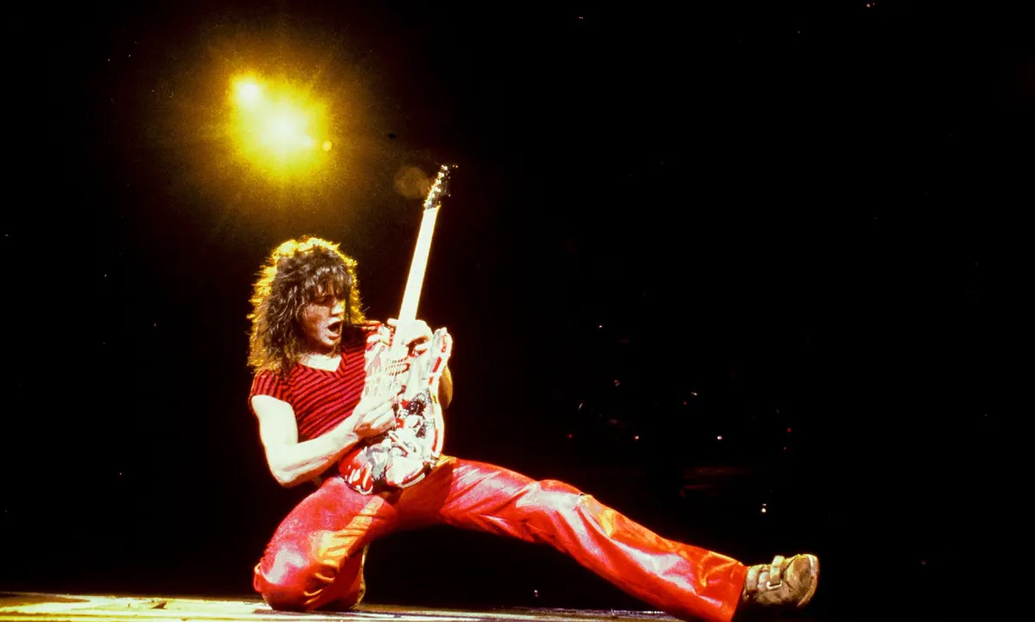
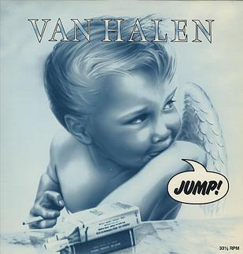
Track 1
Jump, Van Halen

Slide 90
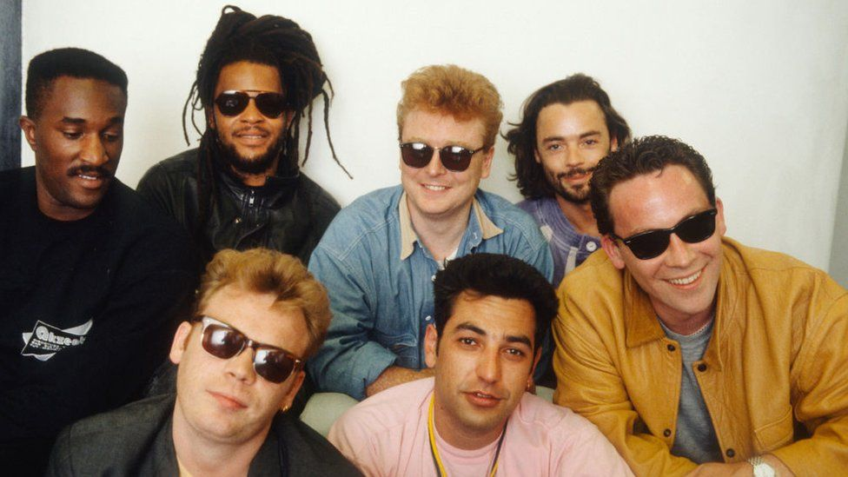
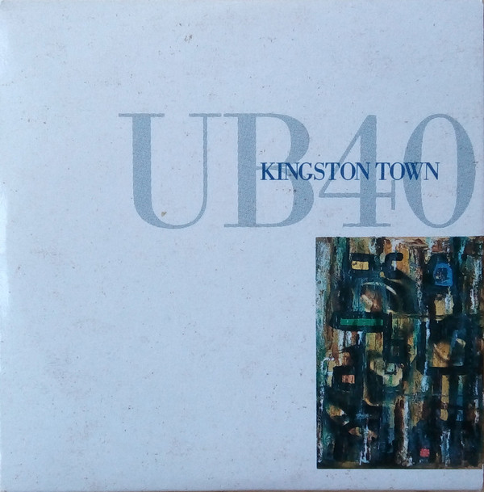
Track 2
Kingston Town, UB40

Slide 91
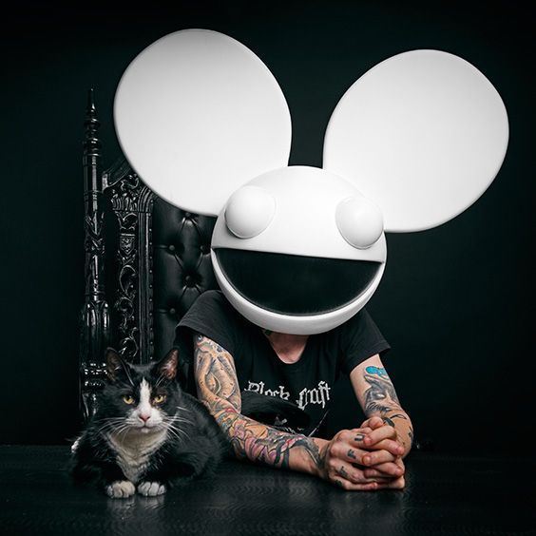
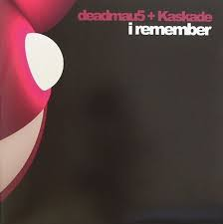
Track 3
I Remember, deadmau5

Slide 92
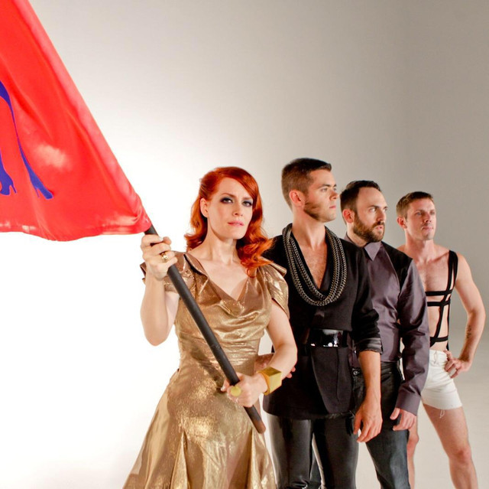

Track 4
Take Your Mama, Scissor Sisters

Slide 93


Track 5
Strong, London Grammar

Slide 94


Track 6
Last Request, Paolo Nutini

Slide 95


Track 7
Riders on the Storm, The Doors

Slide 96


Track 8
I'm Not Okay, My Chemical Romance

Slide 97


Track 9
An Audience with the Pope, Elbow

Slide 98


Track 10
Without Me, Eminem

